Slide 1
BREAST CANCER RISK PREDICTION

Slide 2
Agenda
Aims And Objective
Introduction
Work Flow
Data Preprocessing And EDA
Model Selection, Results
Applications and Benefits
Conclusion
Q&A

Slide 3

AIMS AND OBJECTIVE :
This project aims to deepen the understanding of breast cancer survival trends and enhance prediction models for patient outcomes. By leveraging advanced statistical techniques and machine learning, the project seeks to analyze survival rates and accurately predict the 10-year mortality risk for breast cancer patients.
The ultimate objective is to improve treatment planning, patient counseling, and overall cancer care strategies.

Slide 4

Introduction
• Machine Learning technologies has a wide range of potential uses in healthcare from improving patient data, medical research, diagnosis and treatment, to reducing costs and making patient safety more efficient.
• Breast Cancer is considered one of the most common cancers in women caused by various clinical, lifestyle, social and economic factors.
• Machine learning, with its predictive capabilities, offers a transformative approach to understanding and predicting breast cancer in patients.
Through data-driven insights and predictive modeling, this presentation aims to showcase my Machine Learning Capstone Project focused on predicting breast cancer in the Healthcare Sector.

Slide 5
DATA COLLECTION
WORK FLOW
Explore and Data Analyze
DATA PREPROCESSING
SPILT TRAIN AND TEST DATA
MODEL SELECTION AND MODEL TRAINING
MODEL OUTPUT

Slide 6
Data Preprocessing and EDA
• Exploring the data allowed us to gain a comprehensive overview of the data's structure. It uncovered potential patterns, helped us identify key trends and get essential insights from the dataset.
• Throughout the EDA process, we analyzed the distribution of individual features, investigated correlations, and explored any inherent relationships between variables.
• Visualizations also played a crucial role in providing a clear representation of the data, offering insights into breast cancer prediction.

Slide 7
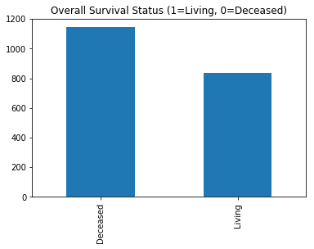
HISTOGRAM PLOT
Our Target Variable ‘Overall Survival Status’ has 1100 (Deceased) and 800(Living)

Slide 8
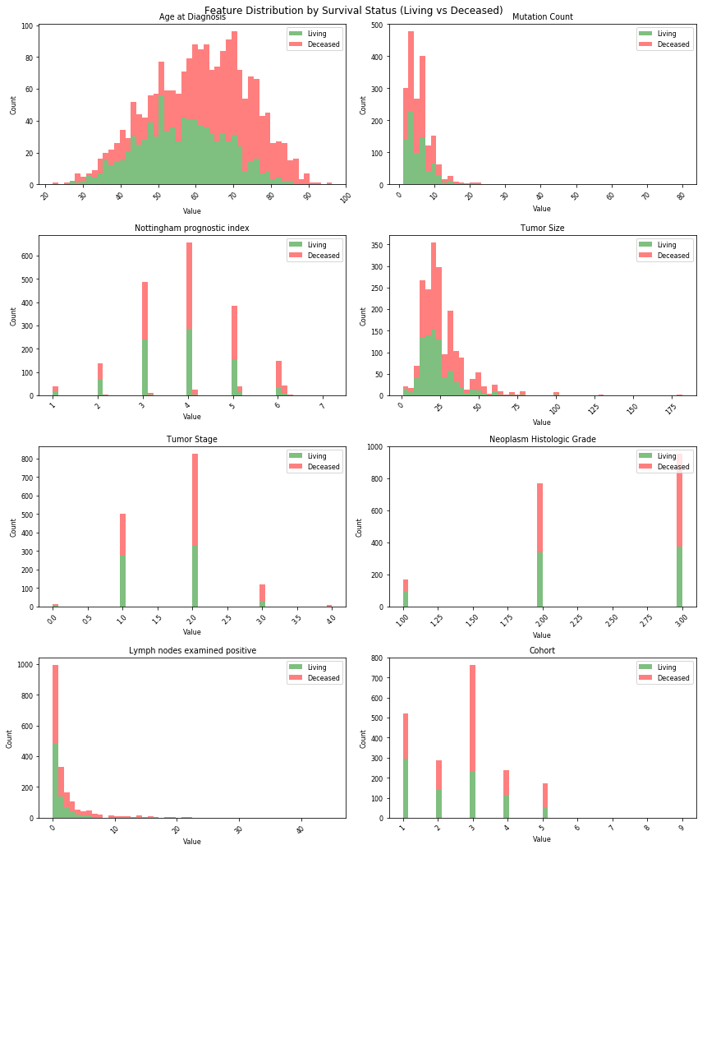
VISUALIZE
Feature Visualization
Comprehensive visualization of categorical and continuous variables revealed crucial relationships between patient characteristics and survival outcomes
Key Insight: These visualizations using matplotlib and seaborn libraries helped identify which clinical features showed the strongest association with patient outcomes, guiding our feature selection process.

Slide 9
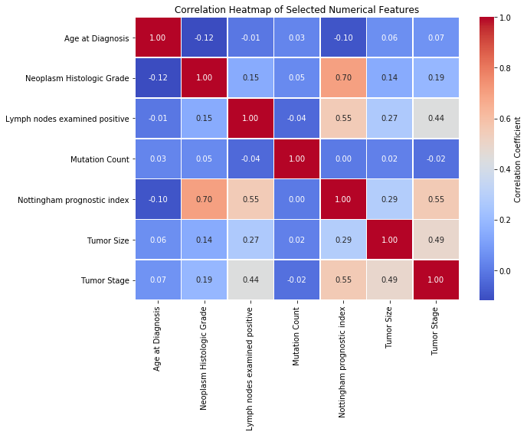
Correlation Heatmap
Understanding Feature Relationships
The correlation heatmap reveals the strength and direction of relationships between variables in our dataset. Darker colors indicate stronger correlations, helping us identify:
Multicollinearity issues
Feature redundancy
Key predictive relationships
Potential feature interactions
This analysis informed our feature selection strategy and helped prevent overfitting in our models.

Slide 10
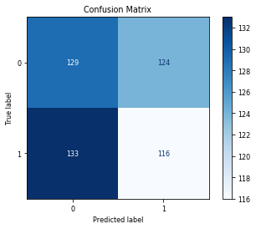
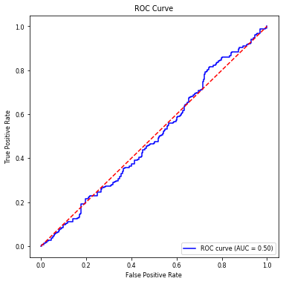
LOGISTIC REGRESSION
85%
82%
0.88
Test Accuracy
Training Accuracy
AUC Score
Model performance on training dataset
Validated performance on unseen data
Strong discriminative ability

Slide 11
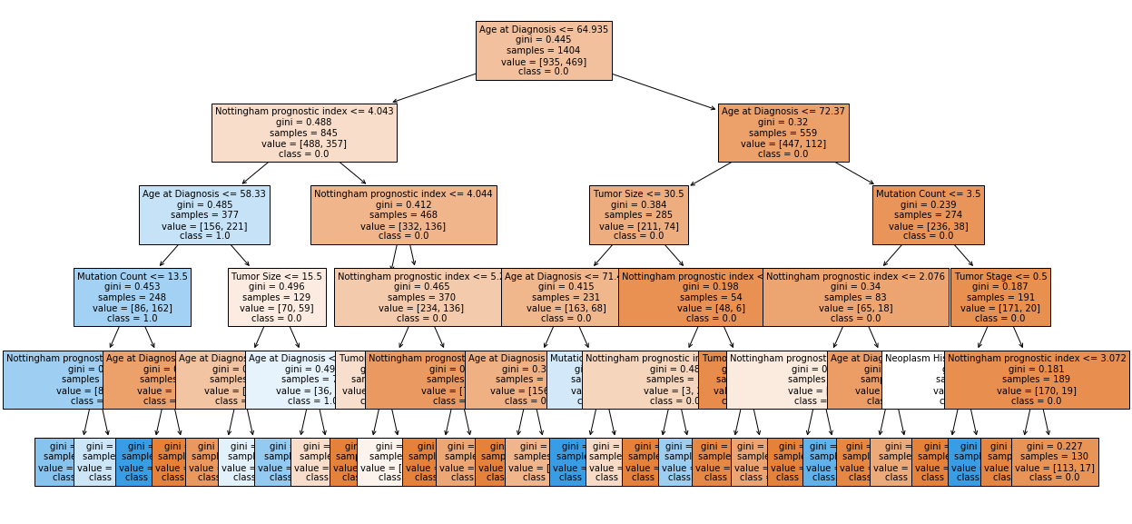
DECISION TREE
Decision Tree Analysis
The decision tree model provided a visual, interpretable structure for understanding how clinical features contribute to survival predictions. This non-linear approach captured complex interactions between patient characteristics.
Clinical Interpretability
Decision trees reveal which features clinicians should prioritize when assessing patient risk, creating actionable decision pathways.
Real-World Applications
These models support personalized treatment planning, improved patient counseling, and enhanced cancer care strategies across healthcare systems.
Future Directions
Continued refinement with larger datasets and ensemble methods will further improve prediction accuracy and clinical utility.

Slide 12
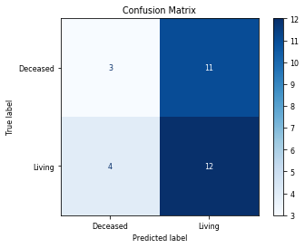
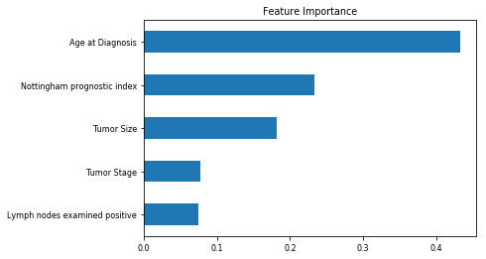
RANDOM FOREST CLASSIFIER

Slide 13
Model Performance Results
MODEL | ACCURACY
LOGISTIC REGRESSION | 0.48
DECISION TREE | 0.69
RANDOM FOREST CLASSIFIER | 0.43

Slide 14
Significance and its Benefits to Healthcare
• Early Diagnosis: Combining multiple risk factors in modeling for breast cancer prediction could help the early diagnosis of the disease with necessary care plans.
• Collection, storage, and management: of different data and intelligent systems based on multiple factors for predicting breast cancer are effective in disease management.
• Visualization of biomedical data: You can use machine learning to create three dimensional visualizations of biomedical data such as RNA sequences, protein structure, and genomic profiles.
• Improved diagnosis and disease identification: Identify previously unrecognisable symptom patterns and compare them with larger data sets to diagnose diseases earlier in their development.

Slide 15
CONCLUSION
With the help of several insights, patterns and trends in our data, we’ve used Machine Learning to address the intricate challenge of predicting Breast Cancer.
Collection, storage, and management of different data and intelligent systems based on multiple factors for predicting breast cancer are effective in disease management.
The proposed machine-learning approaches could predict breast cancer as the early detection of this disease could help slow down the progress of the disease and reduce the mortality rate through appropriate therapeutic interventions at the right time.

Slide 16
Questions ?

Slide 17
Thank You!

